Slide 1
Effective Persistence Using ORM with Hibernate
View Persistence with Hibernate course details at www.edureka.co/persistence-with-hibernate
For Queries:
Post on Twitter @edurekaIN: #askEdureka
Post on Facebook /edurekaIN
For more details please contact us:
US : 1800 275 9730 (toll free)
INDIA : +91 88808 62004
Email Us : sales@edureka.co

Slide 2
Objectives
At the end of this webinar, you will be able to understand:
What is Java Enterprise
Java Enterprise architecture
Hibernate
Java EE with Hibernate
Easy persistence with Hibernate
Hibernate with Spring
Session & Transactions using Spring & Hibernate
Hibernate with search mechanism

Slide 3

JavaEE – Enterprise Edition
Provides collection of APIs and runtime environments to support Enterprise applications
Community driven software
Defines standard specifications which can be implemented by vendors
Provides services for
i) Persistence
ii) Messaging
iii) Web
iv) Transactions
Web services support using JAXRS(Rest) and JAXWS(SOAP)

Slide 4
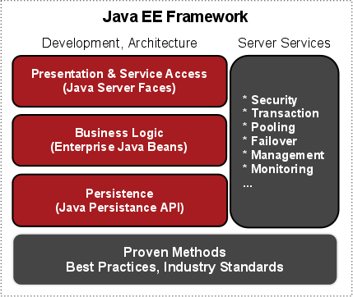

Slide 5

Hibernate
An Object relational mapping library of java language for Object persistence and SQL databases
Found in 2001 by Gavin King
Transparent persistence of java objects with relational database
Provides query language in synch with SQL
Open source library
Provides solutions for object relational impedance mismatch problems

Slide 6


JavaEE with Hibernate
Objective is to solve the complexities existed in EJB2 persistence architecture.
Provided an effective Java persistence API enabling hibernate to work with different databases easily
Annotations provide meta data about table column definitions at the model level.
Entities are developed independent of the underlying database
Oracle
Mysql
Derby

Slide 7
Persistence using Hibernate
Provides a simple API for storing and retrieving Java objects directly to and from the database
Non-intrusive: No need to follow specific rules or design patterns
Transparent: Your object model is unaware
JavaObject
SQL Table
int id;
String name;
String getName()
int getId()
void setName(String)
id [int] primary key,
name [varchar(50)],
Magic Happens Here
(O/R Mapper – i.e. Hibernate)

Slide 8
DEMO : Ease of Persistence Using Hibernate

Slide 9

Spring
An open source framework
Enables to build applications using POJO (Plain Old Java Objects)
Handles the complete infrastructure required for application from end to end
Makes development of JavaEE (Java EnterPrise Applications) easier
Light weight and transparent
Use of IOC Containers
Supports ORM and Transaction Management

Slide 10
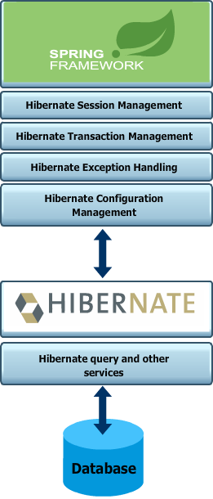
Spring with Hibernate
An extensive support for ORM frameworks like Hibernate , JPA
Provides complete infrastructure for any ORM layer used in the application
IOC of spring handles the SessionFactory instances of hibernate
Configurations of hibernate are taken care efficiently by spring application contexts
Use of hibernate.cfg.xml can be taken care by spring applicationContext.xml
Declarative Transaction management
Built in support for exception handling

Slide 11
Transaction Management with Spring
Spring supports two different approach for transaction management:
Programmatic Transaction Management
Transactions are managed by programming codes
Highly flexible
Difficult in maintenance
Spring TransactionTemplate is used for programmatic approach
Declarative Transaction Management
Transactions are handled declaratively by XML or Annotation
Will have lesser impact with the code of application
Extensive support from Spring AOP
Most widely used

Slide 12
Spring AOP Transaction Management
Spring Aspect Oriented Programming enables to declare transaction declaratively with Aspect
Aspect scatters across methods, class and even objects
Can be used in xml and annotations
AOP declarative transaction:-
Transaction-handling advice is created using <tx:advice/> and pointcut is defined to make transactional advice that matches all methods
Advice begins transaction on before calling the method
On successful execution of method advice commits the transaction
On failure advice rolls back
<tx:advice id="txAdvice"
transaction-manager="transactionManager"> <tx:attributes>
<tx:method name="create"/>
</tx:attributes>
</tx:advice>
<aop:config>
<aop:pointcut id="createOperation" expression="execution(* com.tutorialspoint.StudentJDBCTemplate.create(..))"/>
<aop:advisor advice-ref="txAdvice" pointcut-ref="createOperation"/>
</aop:config>

Slide 13
DEMO : Spring Transaction Management Using Hibernate

Slide 14

Hibernate OGM
OGM – Object Grid Mapper
It provides Java Persistence API (JPA) support for NoSQL Solutions
Object Relational Mapping for NoSQL Databases
Provides support for most of the NoSQL database types
Scaling of Relational Databases with a NoSQL front end and with no change in domain model

Slide 15
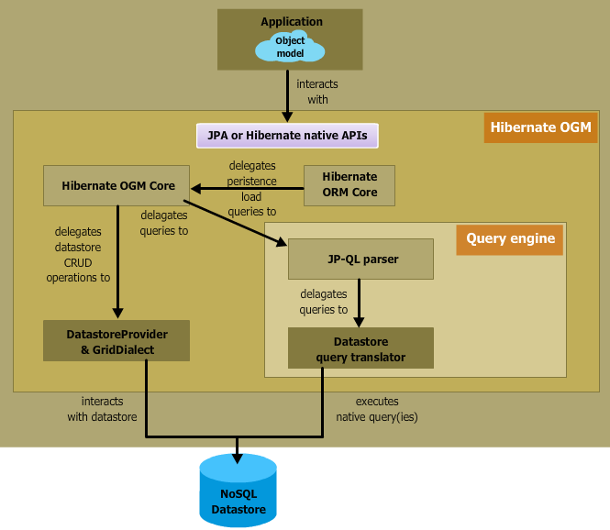
Hibernate OGM - Architecture

Slide 16
DEMO : OGM with Hibernate

Slide 17
Lucene
An Apache library
Full text search capability
Developed on java API
Query results are returned by relevance
Fast ,flexible and stable
Easy to integrate lucence search functionality to application

Slide 18

Lucene – Indexing
One of the most base functionality of Lucene
Fields in the documents are analyzed by the IndexWriter
Creates/Updates the indexes
Indexes created/updated are equivalently stored/updated in directory

Slide 19
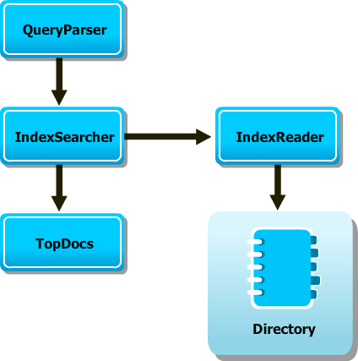
Lucene – Search
Search operation is basically carried via IndexSearcher
Directory having indexes are passed to IndexSearcher
IndexSearcher reads the indexes in the directory with the help of IndexReader
Query to search is created using the QueryParser
Search performed with IndexSearcher against the query created by QueryParser
IndexSeracher returns TopDocs which contains the complete search details

Slide 20
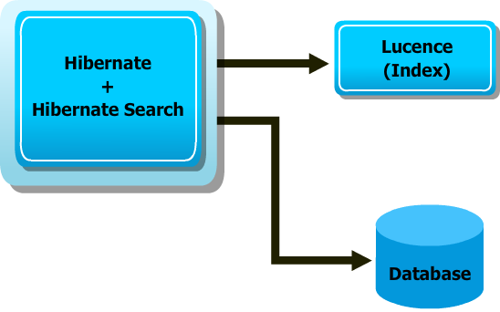
Hibernate Search
Even though Lucence provides very efficient search capabilities , suffers with several mismatches with domain object models
Hibernate Search built on top of the Lucence search engine to address the short comings of lucence in domain object models
Similarly to Hibernate which has been built in top of the SQL databases, Hibernate search built on top of Lucence
Hibernate address the short comings of lucence in domain object models with annotations
Manages entities when query made to database or as lucence query to index
Search
Request

Slide 21
DEMO - LUCENCE APPLICATION

Slide 22
Course Topics
Module 1
Introduction to ORM and Hibernate
Module 2
Persistence and Session Factory
Module 3
Association, Mapping & Inheritance
Module 4
Criteria and Query Language
Module 5
Transactions ,Filter and Performance
Module 6
Search and Validation Framework
Module 7
OGM, NoSQL and Spring
Module 8
Project

Slide 23
How it Works?

